Slide 1


Our Christian Values

Slide 2

We are thinking about the Christian value of :
Truthfulness
‘Dear children, let us not love with words or speech but with actions and in truth.’ 1 John 3:18
‘Whoever is careless with the truth in small matters cannot be trusted with important matters.’ Albert Einstein

Slide 3
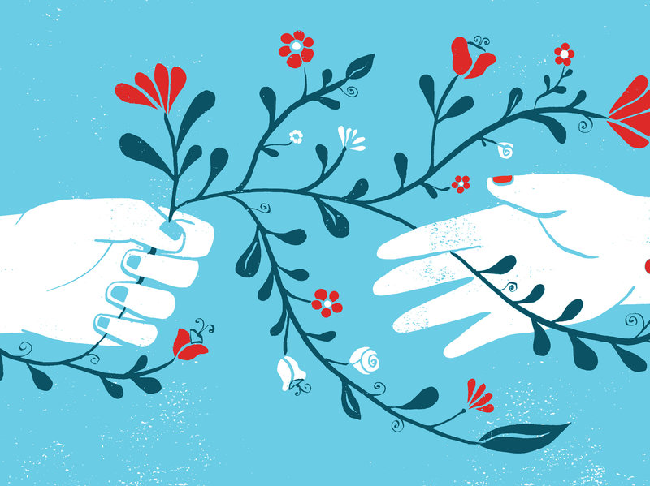
We are thinking about the Christian value of :
Compassion
‘Be kind and compassionate to one another, forgiving each other, just as in Christ God forgave you.’ Ephesians 4:32

Slide 4
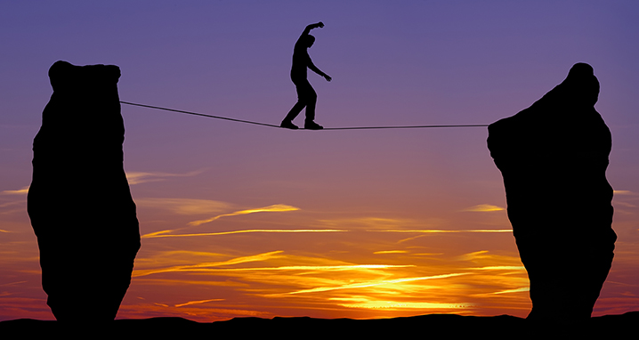
We are thinking about the Christian value of :
Courage
‘Be of good courage and he shall strengthen your heart, all you that hope in the Lord’ Psalm 27: 14
‘Being a gymnast means having the strength to hold on and the courage to let go’ Simone Biles

Slide 5
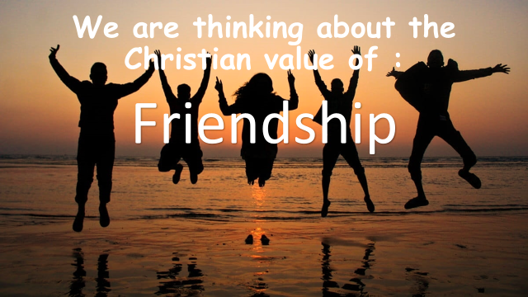
‘A sweet friendship refreshes the soul’ Proverbs 27:9
‘Friendship is the hardest thing in the world to explain. It’s not something you learn in school. But if you haven’t learned the meaning of friendship, you haven’t really learned anything’ Muhammad Ali

Slide 6

‘He has filled them with skill to do all kinds of work as engravers, designers, embroiderers in blue, purple and scarlet yarn and fine linen, and weavers- all of them skilled workers and designers’ Exodus 35:35
‘If you can dream it, you can do it’ Walt Disney

Slide 7
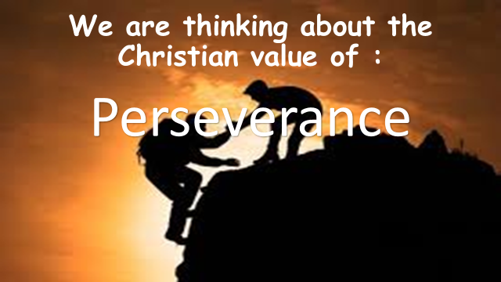
‘And let us run with perseverance the race marked out for us, fixing our eyes on Jesus, the pioneer and perfecter of faith’ Hebrews 12:1-2
‘I’ve always believed that if you put in the work, the results will come’ Michael Jordan

