Slide 1

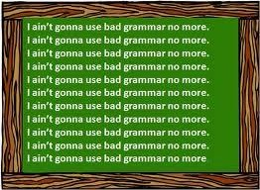

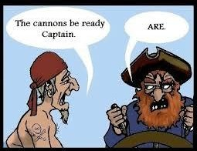


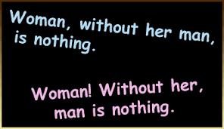


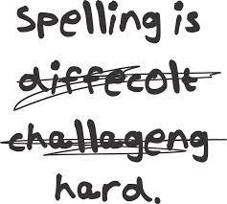

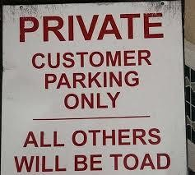
Grammar, Punctuation
and Spelling Workshop for Parents

Slide 2
The Aims Of This Evening
To tell you about the grammar, punctuation and spelling expectations for each year group.
To share the terminology used in grammar, punctuation and spelling.
Have a go yourself!
Questions and helpful tips for home!

Slide 3
What does my
child need
to know
year?
by the end of
their
school
The new curriculum expects children to tackle more challenging grammar earlier on, for example:
(was Year 4).
- Subordination and co-ordination in Year 2
- Prepositions in Year 3
(was Year 5).
- Modal verbs in Year 5 (not previously taught).
- Subject and object in Year 6 (not previously taught).
- The subjunctive in Year 6 (not previously taught).

Slide 4
Grammar and Punctuation in
Reception
The use of correct grammar is modelled through speech in the first instance and then through reading and writing.
We expect the children to use the correct forms of past, present and future tense when talking about events and to express themselves effectively showing awareness of the listeners needs.

Slide 5
Spelling in Reception
Know all of the individual letter
sounds and names.
They should know all of the phonemes taught in phases 2 and 3 for example:
ch sh ai or igh

Slide 6
We use strategies such as sound buttons which enable children to read simple words.
that night rain

Slide 7
Phoneme frames help the children to write the individual phonemes needed to construct words.
s | a | ck
th | i | s

Slide 8

We also use ‘Robot Arms’ to move when sounding out individual phonemes. This helps some children to hear sounds for spelling.

Slide 9
The new Key Stage 1 GPS test
The new national curriculum was assessed for the first time in May 2016.
The test consists of two
components.
Paper 1- A spelling task.
Paper 2- Grammar based questions.

Slide 10

Grammar and Punctuation
Prefixes and Suffixes
Year 1 - The prefix –un.
I tied the ribbon.
I untied the ribbon.
Year1 - Regular plural noun suffixes –s or –es
dog
wish
Year 1 - Suffixes
help
dogs
wishes
helping, helped, helper
Year 2 - Use of suffixes –er, – est and –ly
large slow
larger, largest slowly

Slide 11
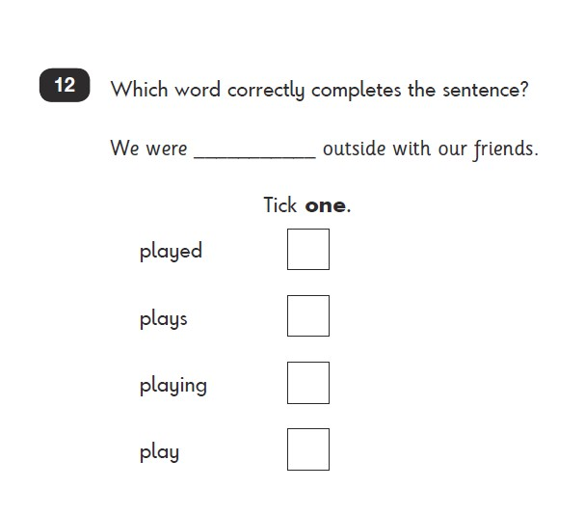


Slide 12
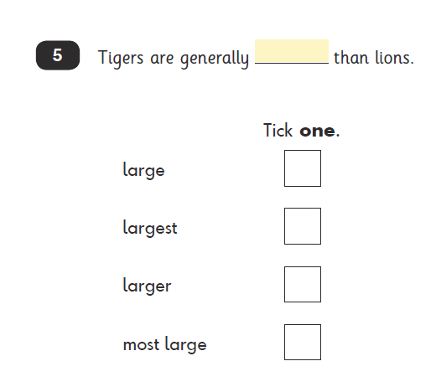

Slide 13
Grammar and Punctuation
Sentences
There are 4 types of sentence.
  Statement
  Question
  Command
  Exclamation

Slide 14
Did you empty the dishwasher?
You’ve emptied the dishwasher!
Empty the dishwasher.
You did empty the dishwasher.
Question
Exclamation
Command
Statement

Slide 15
Grammar and Punctuation
Punctuation
Full stops
I go to school.
Capital Letters
Come to my house and you can play with Sarah.
Question marks
Will you go with me?
Exclamation marks
Hi! It’s great here!
Commas
My interests include reading, cooking, dogs and horses.

Slide 16
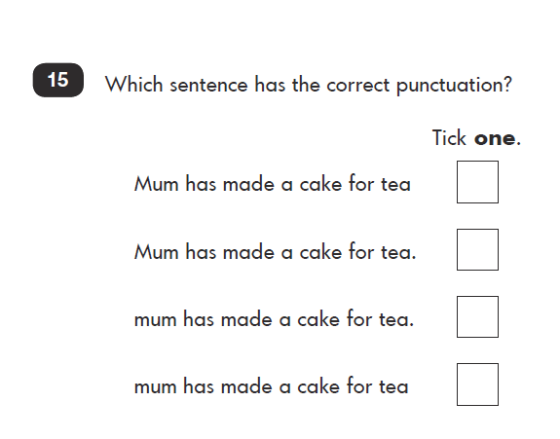

Slide 17
Grammar and Punctuation
Apostrophes
Apostrophes indicate missing letters/contractions.
is not
I will
isn’t
I’ll
Apostrophes indicate possession.
the dog’s bowl

Slide 18
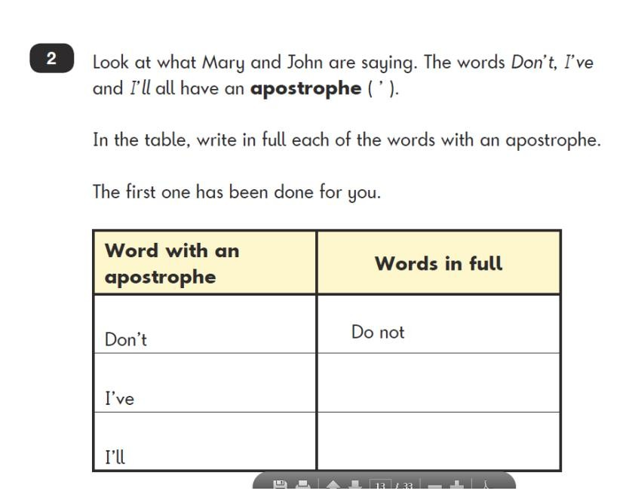
I have
I will

Slide 19
Grammar and Punctuation
Word classes
Nouns
cat, Ben
Adjectives.
red
Verbs
kick, feel
Adverbs
peacefully, carefully, tomorrow, today

Slide 20
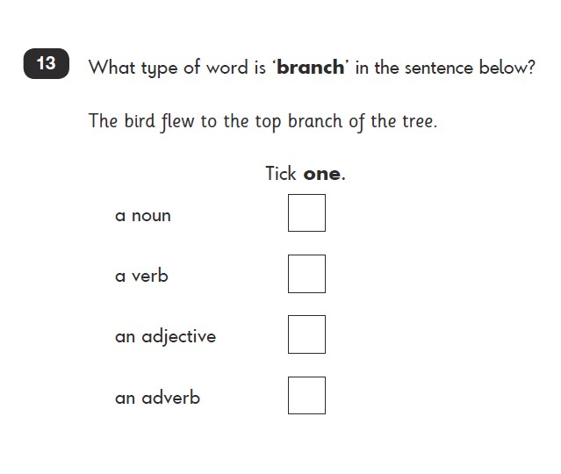

Slide 21
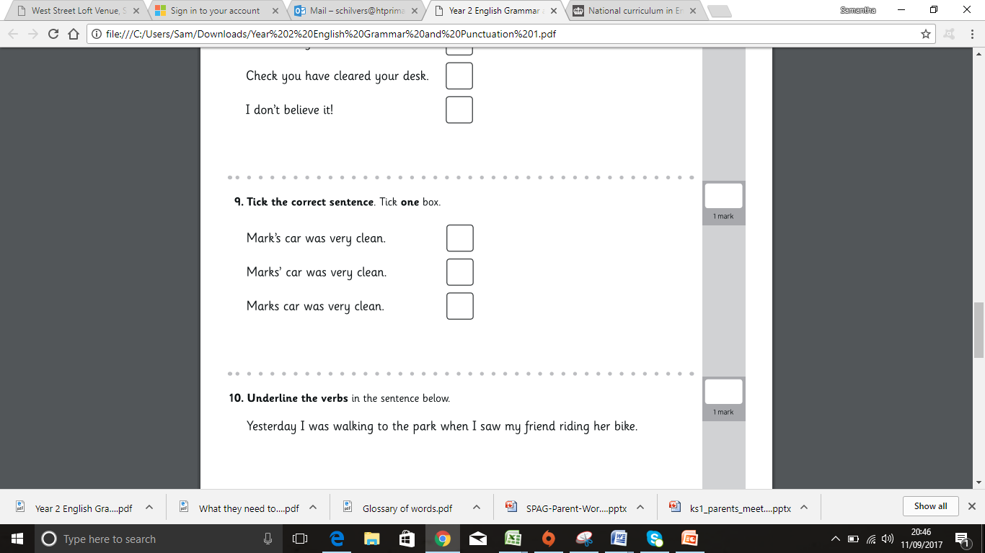

Slide 22
Grammar and Punctuation
Sentence Types
Simple sentence
The dragon guarded the cave.
Compound sentence
The dragon guarded the cave and he scratched the ground near the entrance.
Conjunctions
because so but

Slide 23
Grammar and Punctuation
Verb tenses
Present/past
Jack is eating his lunch
Jack ate his lunch

Slide 24
Spelling
Taught at least 3 times per week.
Year 1 – phase 3 to phase 5 Year 2 – revision of phase 5 and year 2 spelling expectations.
Year 1 and 2 have common
exception words.

Slide 25
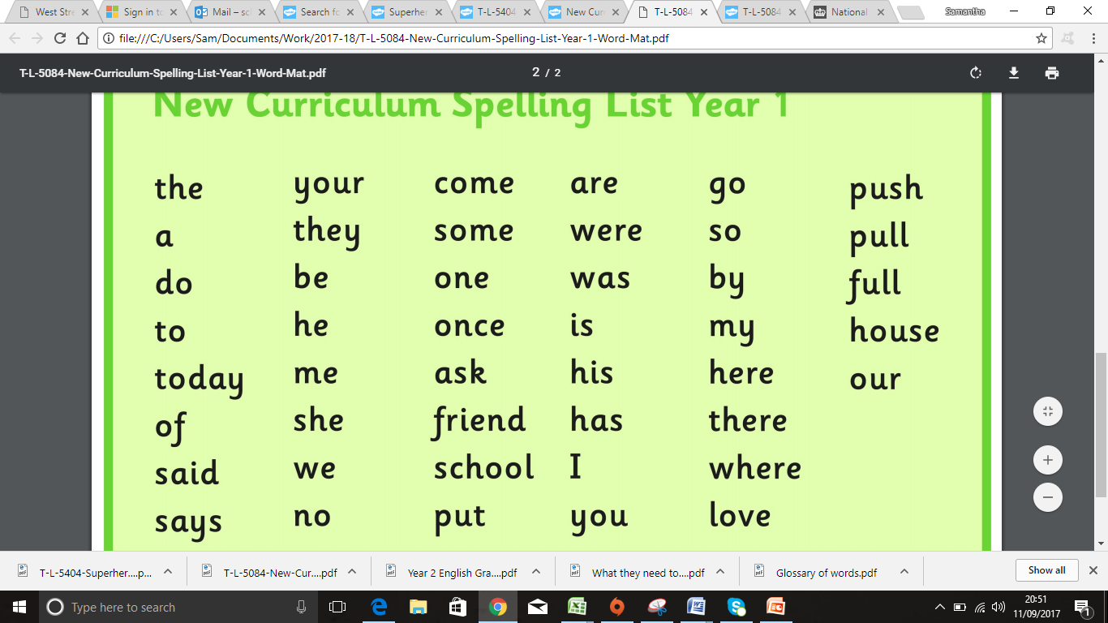

Slide 26
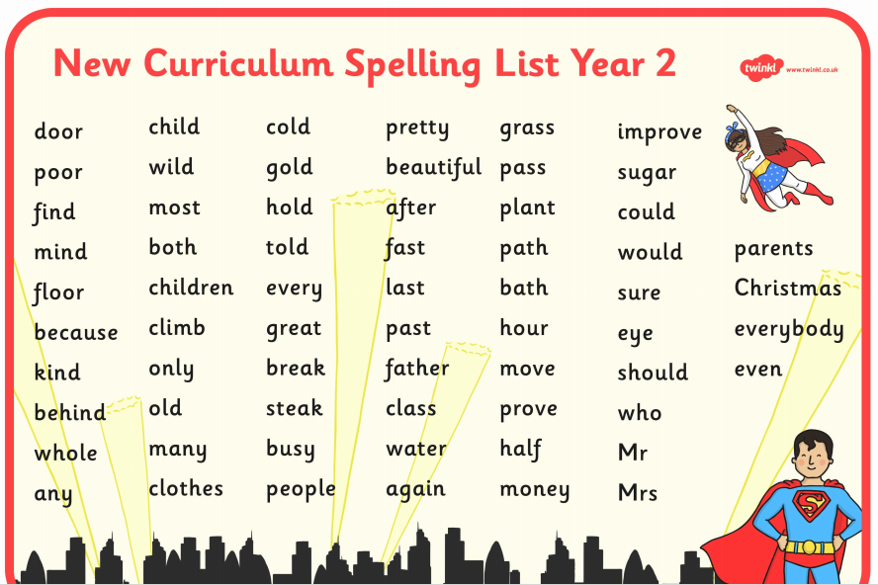

Slide 27
2017 KS1 Spelling Test
1. The dentist told me to open my ______________.
mouth
fixed
2. My older brother ____________ our fence.
bathroom
3. Where is the ______________?
Notes:
Mouth, fixed, bathroom

Slide 28
Key Stage 2
The programme of study for English in the 2014 National Curriculum places great importance on pupils’ spelling, punctuation and grammar skills.
Grammar has always been taught as part of the National Curriculum, but now there are key concepts linked to year groups: these are the learning objectives the children should have achieved by the end of each year in school (meeting Age-Related Expectations or ARE).
Pupils in Year 6 have to take GPS (Grammar, Punctuation and Spelling) tests as part of their statutory assessments (SATs) in May.

Slide 29
Raised Expectations…
Pupils are expected to learn grammatical terminology (e.g. adverb, subordinate clause) and use it in both discussion and practice.
Some changes have been made to terms older pupils may have been taught lower down the school.
For example, speech marks are now referred to as inverted commas and connectives are now known as conjunctions.

Slide 30

Subordinating or Co-ordinating: that is the question….?
Have a look at the piece of writing in front of you. Talk to the person next to you and see if you can identify the following:
Determiner; indefinite article; subordinating conjunction; co-ordinating conjunction; inverted commas; fronted adverbial; expanded noun phrase; present perfect tense.

Slide 31

Year 3………
Any guesses as to which year group these grammatical terms are from?

Slide 32
When pupils enter Year 3, it is expected that they will be able to:
Consistently use the past and present tense throughout a piece of writing
Use the progressive form of verbs in the present and past tense to mark actions in progress [eg. she is drumming, he was shouting]
Use capital letters, full stops, question marks and exclamation marks to demarcate sentences
Use commas to separate items in a list
Use apostrophes to mark where letters are missing in spelling (e.g. can’t) and to mark singular possession in nouns (eg. the girl’s name)

Slide 33
Form nouns using suffixes such as –ness, –er and by compounding [eg. whiteboard, superman]
Form adjectives using suffixes such as –ful, –less
Use the suffixes –er, –est in adjectives and the use of –ly in Standard English to turn adjectives into adverbs
Been introduced to subordination (using when, if, that, because) and co-ordination (using or, and, but)
Use expanded noun phrases for description and specification [eg. the blue butterfly, plain flour, the man in the moon]
Identify the functions of sentences: statement, question, exclamation or command
Use a range of prefixes and suffixes (see National Curriculum spelling appendix)

Slide 34
Curriculum Expectations – Year 3
Express time, place and cause using conjunctions [eg. when, before, after, while, so, because], adverbs [eg. then, next, soon, therefore], or prepositions [eg. before, after, during, in, because of]
Begin to use paragraphs as a way to group related material
Use headings and sub-headings to aid presentation
Use of the present perfect form of verbs instead of the simple past [eg. He has gone out to play contrasted with He went out to play]
Begin to use inverted commas (speech marks) to punctuate direct speech, e.g.
Eg. “Please go and tidy your room,” begged Mum.

Slide 35
Form nouns using a range of prefixes [for example super–, anti–, auto–] eg. supermarket, antibiotic, automatic
Use the determiners a or an according to whether the next word begins with a consonant or a vowel [eg. a rock, an open box]
Develop word families based on common words, showing how words are related in form and meaning [eg. solve, solution, solver, dissolve, insoluble]
Identify the main clause and the subordinate clause in a sentence:
Due to the strong winds, many flights had to be cancelled.
Subordinate clause
Main clause

Slide 36
Curriculum Expectations- Year 4
Plurals and the possessive –s
Verb inflections
Fronted adverbials
Pronouns and nouns
Paragraphs
Inverted commas
Commas
Apostrophes
Singular and plural possessions
Use Standard English forms for verb inflections instead of local spoken forms.
Eg. Saying we were instead of we was
or saying I did instead of I done

Slide 37
The grammatical difference between plural and possessive –s
Here the children have to understand whether an –s is being used to show plural or possession.
The dogs are playing in the park.
Bob’s ball is round and red.
This shows that more than one dog is playing in the park.
This shows that the ball belongs to Bob.

Slide 38
Noun phrases expanded by the addition of modifying adjectives, nouns and preposition phrases.
Here the children need to expand their noun phrase (The teacher) with adjectives, nouns and prepositional phrases.
The strict maths teacher with curly hair.

Slide 39
Fronted adverbials followed by a comma
A fronted adverbial is similar to an adverb but is made up of more than one word which is then placed at the beginning of a sentence. Fronted adverbials are always followed by a comma.
Later that day, Bob went to the park.
A comma must follow the adverbial.
This is the fronted adverbial, it is telling us when the event happened.

Slide 40
Appropriate choice of pronoun or noun within and across sentences to aid cohesion and avoid repetition
In simple terms, this means not repeating a person’s or object’s name many times when writing.
Bob went to the shop. Bob bought an apple then Bob went home to eat his apple.
Instead we say:
Bob went to the shop. He bought an apple then he went home to eat it.

Slide 41
Use of inverted commas and other punctuation to indicate direct speech
When using speech we need to use a comma after the reporting clause. We then need the end punctuation within inverted commas.
The teacher shouted, “Sit down children.”
Comma after the reporting clause
Inverted Commas
End punctuation, inside inverted commas.

Slide 42
Apostrophes to mark plural possession
This means that the children need to know where to put the apostrophe to show plural possession (belonging to more than one).
The girl’s name.
The girls’ names.
This shows that the name belongs to one girl.
This shows that the name belongs to more than one girl.

Slide 43
Curriculum Expectations -Year 5
Converting nouns or adjectives into verbs using suffixes
Verb prefixes
Relative clauses
Indicating degrees of possibility using adverbs or modal verbs
Devices to build cohesion
Linking ideas using adverbials
Brackets, dashes or commas to indicate parenthesis
Use commas to clarify meaning
Converting nouns or adjectives into verbs using suffixes
Eg. Here the children have to add a suffix to convert the word into a verb.
For example: priority – prioritise; intense – intensify;
hesitant- hesitate

Slide 44
Verb Prefixes
Adding prefixes to verbs eg: dis-, de-, mis-, over- and re-
Like - dislike; select - deselect; understand - misunderstand;
react – overreact; play - replay.
Relative clauses
Relative clauses beginning with who, which, where, when, whose or that.
Eg. The man, who was the tallest, picked the book off the shelf.
Where there is no alternative, always choose the safest route.

Slide 45
Modal Verbs
Eg. might, should, will, must
I should make sure my homework is in on time.
This evening, I can go to the cinema because I have finished all my homework.
Devices to build cohesion
This means to join ideas within and between paragraphs.
For example:-
then, after that, this, at first.
At first, I did my maths homework. After that, I was able to watch TV.

Slide 46
Linking ideas using adverbials
  Time - later Place - nearby Number - secondly
Eg. Later that day…
…he had seen her before
In the woods nearby…
Brackets, dashes or commas
Eg. The woman (with the red coat) was walking down the road.
She was happy to receive the invitation - we think so, anyway – and thanked the family for considering her.
Put all the toys, including Samira’s games, in that cupboard.

Slide 47
Curriculum Expectations - Year 6
Formal and informal speech
Use of the passive voice
Use of subjunctive forms
Linking ideas user a wider range of cohesive devices
Use of the semi-colon, colon and dash
Use of hyphens to avoid ambiguity
And, of course, everything taught in all previous year groups.

Slide 48
Passive Voice
Use of the passive to affect the presentation of information in a sentence.
Eg. I broke the window in the greenhouse.
As opposed to: The window in the greenhouse was broken (by me).
Formal and informal speech
Using appropriate vocabulary for formal speech and writing
Eg. Find out- discover
Ask for- request
Go in - enter

Slide 49
Use of Subjunctive Forms
The difference between structures typical of informal speech, formal speech and writing.
eg. He’s your friend isn’t he?
Use of subjunctive forms – how the verb appears in a sentence. Subjunctives make language appear more formal.
eg.
If I was rich, I’d buy a Ferrari.
If I were rich , I’d buy a Ferrari.
Now that I know, I wish I hadn’t gone.
If ever I had know, I would never have gone.

Slide 50
Cohesive devices
Linking ideas across paragraphs using repetition of a word or phrase
Use of adverbials such as on the other hand, in contrast or as a consequence
Ellipsis eg. …
Layout devices for example headings, sub-headings, columns, bullets or tables

Slide 51
Punctuation
Semi-colon
Eg. It was a clear cold night; the moon and stars could be seen easily.
Colon to introduce a list
Eg. These are the items in my pencil case: a ruler, a pen and a pencil.
Hyphens to avoid ambiguity
Eg. Man eating shark versus man-eating shark, or recover versus re-cover

Slide 52
Spelling
There is a statutory spelling list for each year group, split into a Year 3 and Year 4 list and a Year 5 and Year 6 list. It is important that the children understand the meaning of the words and can (and should) use them in their independent writing.
Spelling homework in KS2: we are encouraging children to learn their spellings in a visual, multi-sensory way
Eg. Spell words out using dried pasta
Use rainbow writing
Write a poem or story
Dictionary definitions

Slide 53

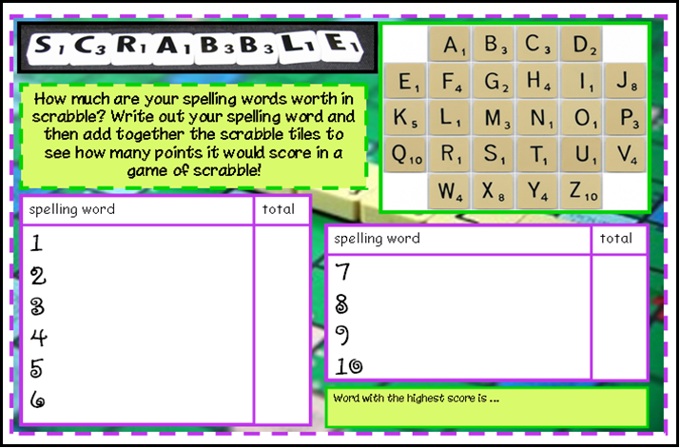
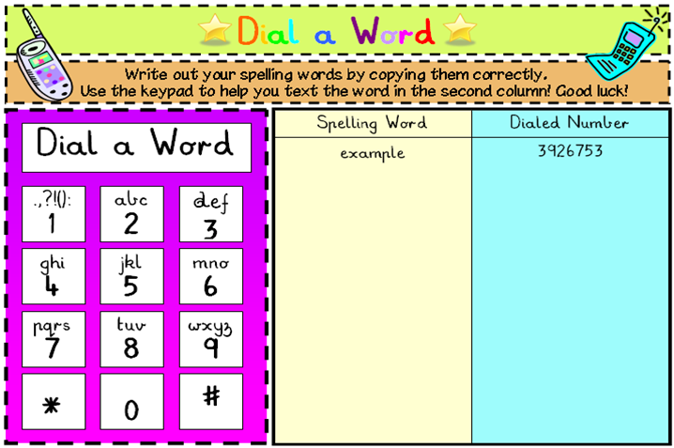
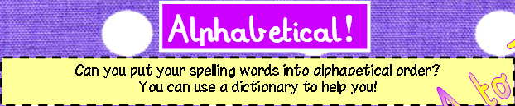

Slide 54
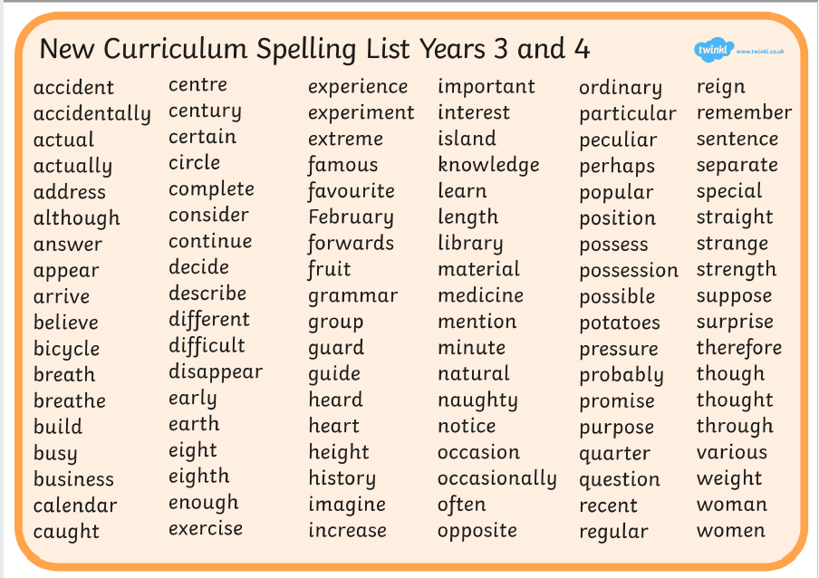

Slide 55
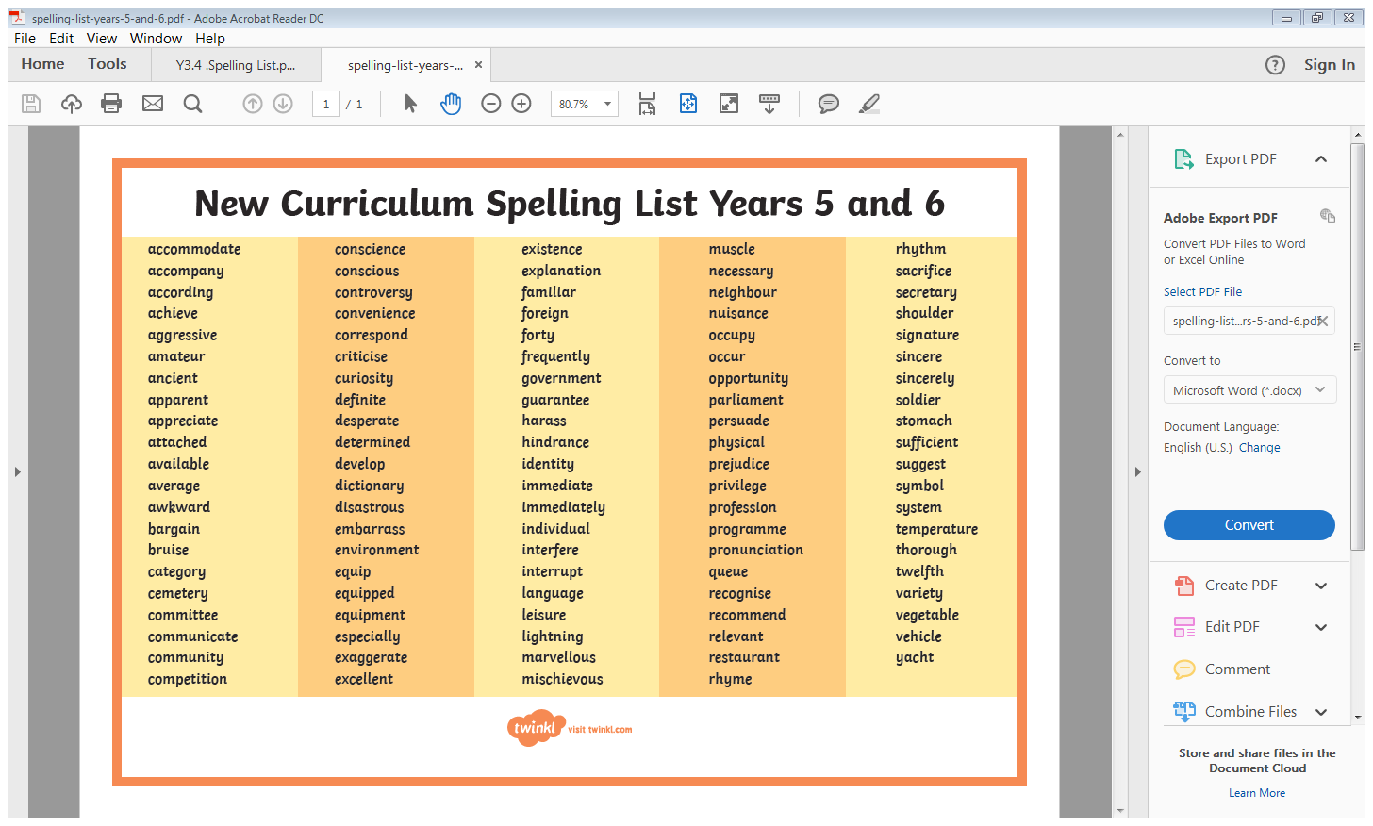

Slide 56
Helping at home
Read, read, read!
Have conversations!
Homework
Websites
http://www.funenglishgames.com/games.html http://www.bbc.co.uk/bitesize/ks1/literacy/

Slide 57



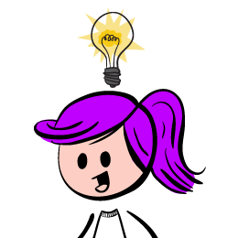

That’s all folks . . .
Any questions….?

