Slide 1


Our Christian Values

Slide 2

We are thinking about the Christian value of:
Peace
‘God will give you peace to help you through your storm’ Isaiah 26:3
‘Peace begins with a smile’ Mother Teresa

Slide 3

We are thinking about the Christian value of :
Forgiveness
‘The weak can never forgive. Forgiveness is the attribute of the strong.’ Mahatma Gandhi

Slide 4

We are thinking about the Christian value of :
Truthfulness
‘Dear children, let us not love with words or speech but with actions and in truth.’ 1 John 3:18
‘Whoever is careless with the truth in small matters cannot be trusted with important matters.’ Albert Einstein

Slide 5
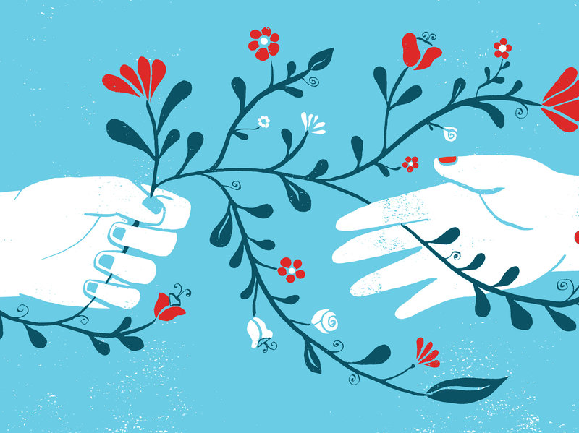
We are thinking about the Christian value of :
Compassion
‘Be kind and compassionate to one another, forgiving each other, just as in Christ God forgave you.’ Ephesians 4:32

Slide 6
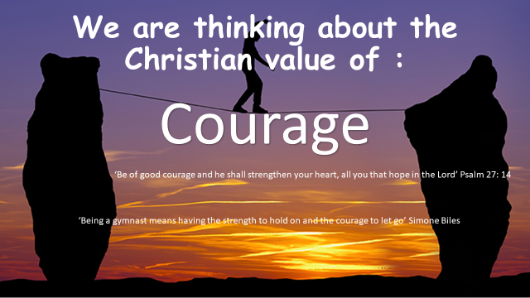

Slide 7
