Slide 1

KS1
Harvest Celebration
Thursday 3rd October
9:30am
“You visit the earth, and water it;
You enrich it with the river of God, which is full of water”
Psalms 65:9

Slide 2
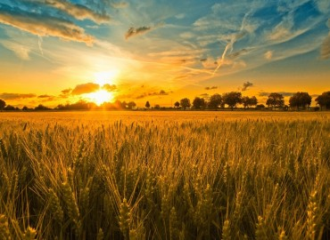
Welcome - Revd. Michael
Hymn – It’s harvest time
4 Bars and 4 counts (intro)
Chorus
It’s harvest time, (Harvest time)
It’s harvest time, (Harvest time)
It’s harvest time,
Let’s celebrate it!
We’re here to give our thanks
For the good things that we have,
Celebrate, celebrate,
It’s harvest time.

Slide 3
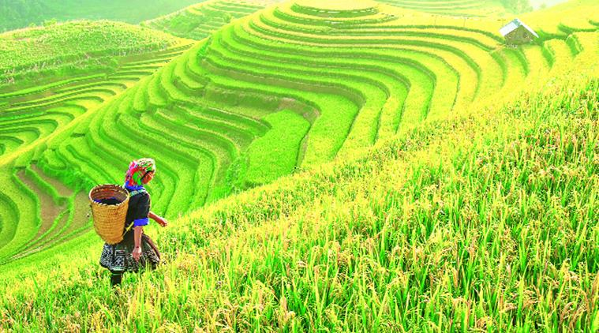
Verse 1
China is the place to go for paddy fields of rice,
Food from ev’ry corner of the world.
If we work together we can lend a helping hand,
Food is precious, gathered from the land.
(4 bars)
Chorus
Verse 2 India is busy growing diff’rent kinds of tea,
Food from ev’ry corner of the world.
If we work together we can lend a helping hand,
Food is precious, gathered from the land.

Slide 4
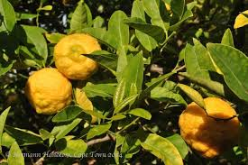
Chorus
Verse 3
Spain is growing oranges and lemons just for you,
Food from ev’ry corner of the world.
If we work together we can lend a helping hand,
Food is precious, gathered from the land.
Chorus
Harvest time!

Slide 5
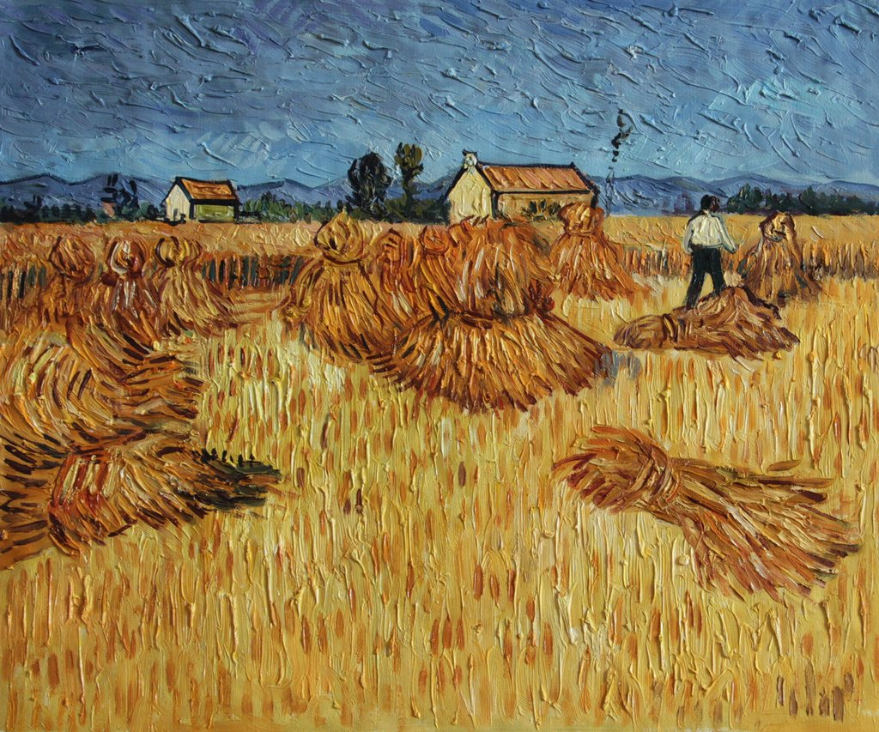
Year 1 – A harvest poem

Slide 6
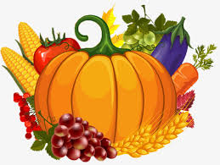
Hymn – Harvest Samba
4 Bars intro
Cabbages and greens,
Broccoli and beans,
Cauliflower and roasted potatoes,
Taste so good to me!
Apricots and plums,
Ripened in the sun,
Oranges and yellow bananas,
Good for everyone
It’s another Harvest Festival
When we bring our fruit and vegetables,
‘Cause we want to share the best of all
The good things that we’ve been given.

Slide 7
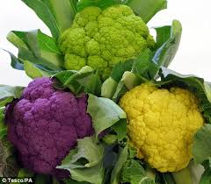
It’s another opportunity,
To be grateful for the food we eat,
With a samba celebration to
Say ‘Thank you’ to God the Father.
(4 bars)
Golden corn and wheat,
Oats and sugar beet,
Fluffy rice and tasty spaghetti,
Wonderful to eat!
Coffee, cocoa, tea,
Growing nat’rally,
Herbal plants and all kinds of spices,
Very nice indeed!

Slide 8
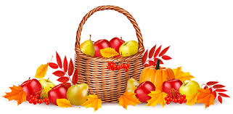
It’s another Harvest Festival
When we bring our fruit and vegetables,
‘Cause we want to share the best of all
The good things that we’ve been given.
It’s another opportunity,
To be grateful for the food we eat,
With a samba celebration to
Say ‘Thank you’ to God the Father.

Slide 9
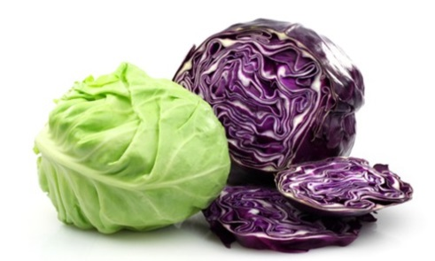
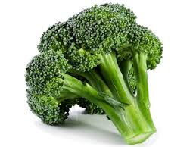
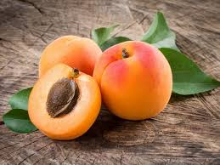
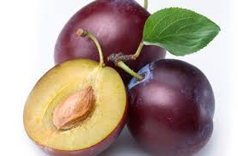
MIDDLE 8 – Once only
Thank you for the harvest, Cabbages and greens,
Thank you for your goodness, Broccoli and beans,
For all of the fruit and vegetables Cauliflower and roasted potatoes,
And the wonderful things that grow. Taste so good to me!
Thank you for the harvest,
Thank you for your goodness, Apricots and plums,
For all of the fruit and vegetable Ripened in the sun,
And the wonderful things that grow. Oranges and yellow bananas,
(ALL TOGETHER FIRST TIME) Good for everyone!

Slide 10
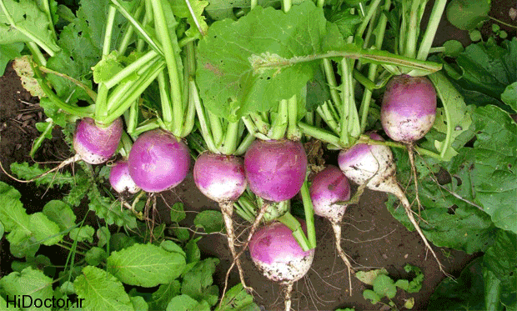
A song for Harvest – year 2

Slide 11
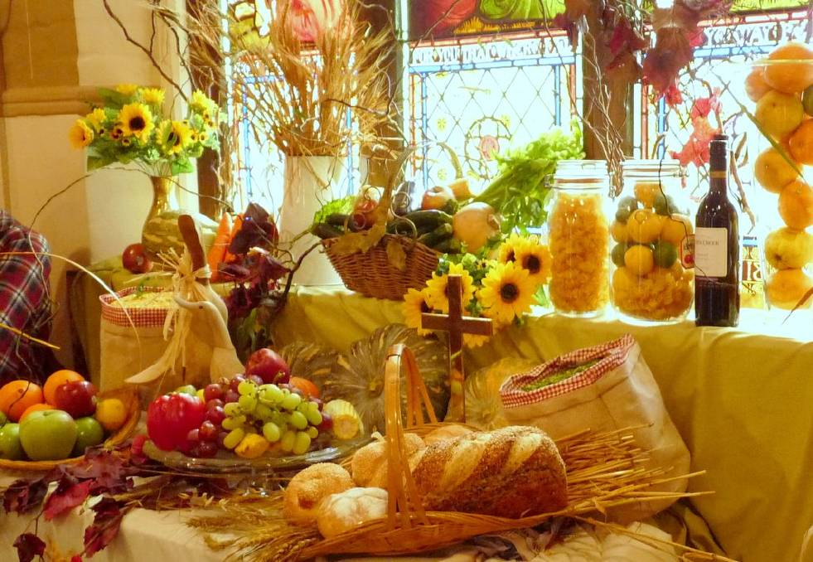
Prayers by Years 1 and 2
Charitable Presentation of Harvest Gifts

Slide 12
Blessing by Revd. Michael
Thank you for joining us today.
Thank you to everyone for their generous donations which will support the Family Support Work Charity.

