Slide 1


Our Christian Values

Slide 2

We are thinking about the Christian value of :
Trust
“Do not let your hearts be troubled. Trust in God; trust also in me.” – Jesus Christ
‘‘Whoever is careless with the truth in small matters cannot be trusted with important matters.’’- Albert Einstein

Slide 3
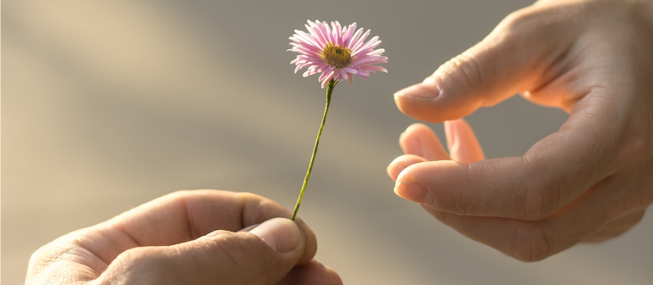
We are thinking about the Christian value of :
Generosity
"Generosity is the most natural outward expression of an inner attitude of compassion and loving-kindness."
- Dalai Lama
“That's what I consider true generosity: You give your all and yet you always feel as if it costs you nothing.” —Simone de Beauvoir

Slide 4
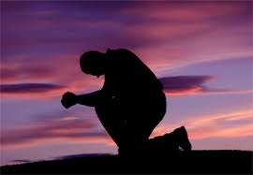
We are thinking about the Christian value of :
Respect and Reverence
‘Even the weakest and most vulnerable, the sick, the old, the unborn and the poor, are masterpieces of God's creation, made in his own image, destined to live for ever, and deserving of the utmost reverence and respect.’
Pope Francis
‘I love making new friends and I respect people for a lot of different reasons.’ Taylor Swift

Slide 5
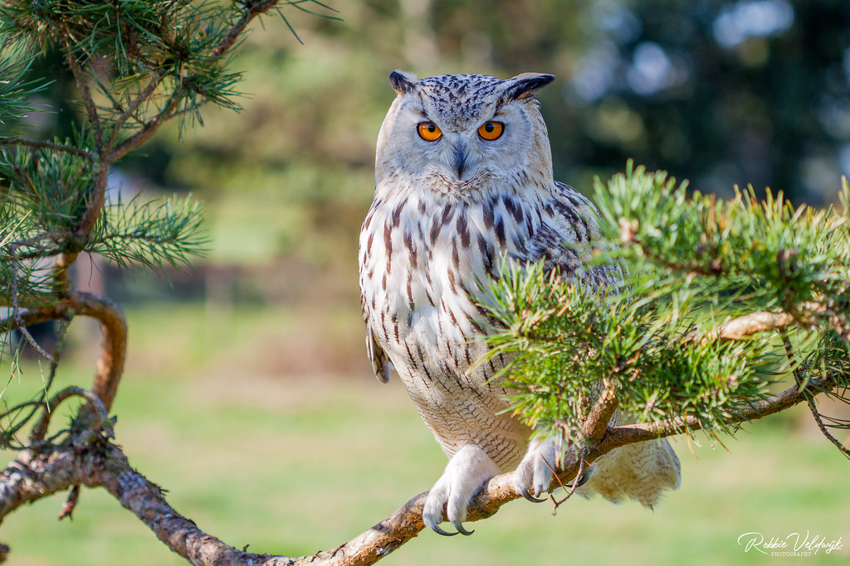
We are thinking about the Christian value of :
Wisdom
‘Who is wise and understanding among you? Let them show it by their good life, by deeds done in the humility that comes from wisdom.’ James 3:13
“Don't Gain The World & Lose Your Soul, Wisdom Is Better Than Silver Or Gold.”
― Bob Marley

Slide 6

We are thinking about the Christian value of:
Responsibility
‘The price of greatness is responsibility.’ Winston Churchill
‘And surely I am with you always to the very end of the age.’ Matthew 28:20

Slide 7

We are thinking about the Christian value of :
Hope
‘’For I know the plans I have for you,’’ declares the Lord, ‘‘Plans to prosper you and not to harm you, plans to give you hope and a future.’’ Jeremiah 29:11

