Slide 1
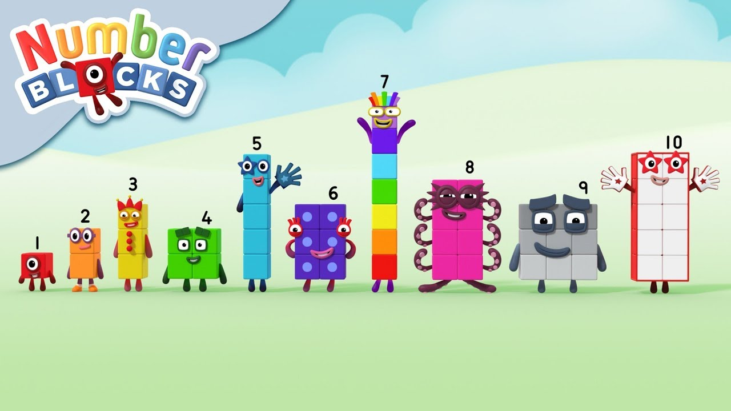
Teaching Maths in EYFS
A Mastery Approach

Slide 2
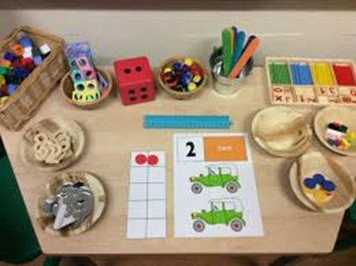
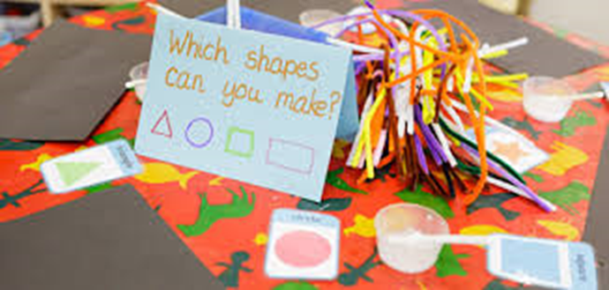
There are two Early Learning Goals for maths. This is what most children in Reception are expected to be able to do by the end of their first year at school.
Number:
• Have a deep understanding of number to 10, including the composition of each number;
• Subitise (recognise quantities without counting) up to 5;
• Automatically recall (without reference to rhymes, counting or other aids) number bonds up to 5 (including subtraction facts) and some number bonds to 10, including double facts.
Numerical Patterns:
Verbally count beyond 20, recognising the pattern of the counting system;
Compare quantities up to 10 in different contexts, recognising when one quantity is greater than, less than or the same as the other quantity;
Explore and represent patterns within numbers up to 10, including evens and odds, double facts and how quantities can be distributed equally.

Slide 3
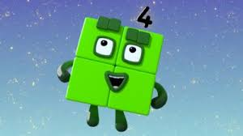
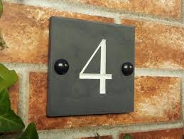

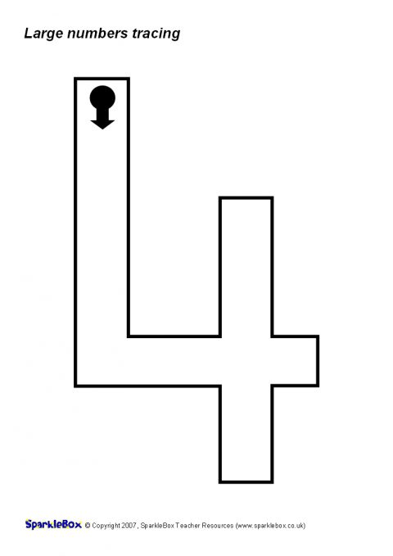
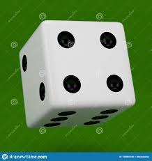
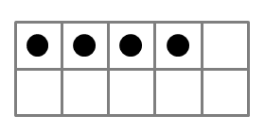


How do we teach a deeper understanding of number in Early Years?
Representing Numbers
We want to develop children’s number sense so that they understand the number rather than just recognising the numeral.
Children need to understand that numbers can be represented in many ways, not just as a written numeral. We use many different objects and pictures to show that numbers can be represented in lots of ways.
Children sometimes need lots of practise to recognise numbers in different forms. We play games that encourages children to recognise and make different amounts in our indoor and outdoor areas.

Slide 4
Counting
When counting, children need to understand these key principles …
• That we need to say one number for each object counted ( One-to-one correspondence) – match one number name to each item to be counted
• Stable order- say the number names in the correct order
• Cardinality – the last number in the count is the total size of the group - how many altogether. Some children continue to count after they have reached the final object as they don’t connect the numbers they are saying to the objects in front of them.
• That we can count objects in any order and the total stays the same.

Slide 5


Recognising amounts – subitising
Subitising is being able to say the number of items in a group without counting them individually e.g. 6 dots on a die: seeing this as two groups of three which we combine to make 6
We use objects to practice this initially and then move on to dots. This is a very important skill when children begin to add and subtract. Using dice is a good way to practise this skill before moving onto objects in different arrangements.
••• ••
•• •• •

Slide 6
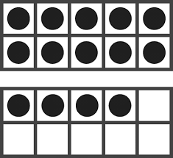
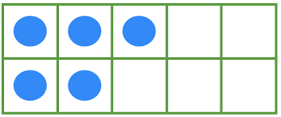
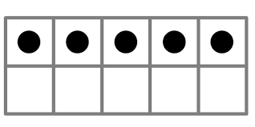
Understanding that the total stays the same even when the objects move
When children first start to use numbers, they often do not understand that if we move objects into another arrangement the total stays the same. We practice this with many different types of objects but a useful tool is using a tens frame to be able to move counters around.​
We also use ten frames a lot to talk about partitioning the numbers.
•
•

Slide 7
Reasoning
Reasoning in maths helps children to be able to explain their thinking, therefore making it easier for them to understand what is happening in the maths they are doing. It helps them to think about how to solve a problem, explain how they solved it and to think about what they could do differently. In Reception, some examples of reasoning are:
• True and false statements eg adding one to a number always makes it smaller
• Spotting incorrect maths eg 1, 2, 3, 4, 6, 5, 7, 8, 9, 10
• Explaining how we know something or how we worked it out .

Slide 8
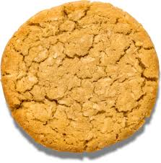
Which cookie is the odd one out? And why?

Slide 9
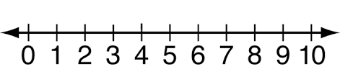

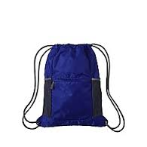
This naughty alien is stealing numbers from the number lines, then putting them in his bag. Which three numbers would you find in his bag?

Slide 10
Problem Solving
Problem solving in maths allows children to use their maths skills in lots of contexts and in situations that are new to them. It allows them to seek solutions, spot patterns and think about the best way to do things rather than blindly following maths procedures.
In Reception, problem solving might include:
• spotting, following and creating patterns
• estimating amounts of objects
• predicting how many times they can do something in a minute
• sharing objects between different groups – particularly when the amount of groups change and the amount of objects stays the same • finding different ways to partition numbers eg 5 could be 5+0, 4+1, etc

Slide 11
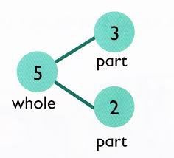
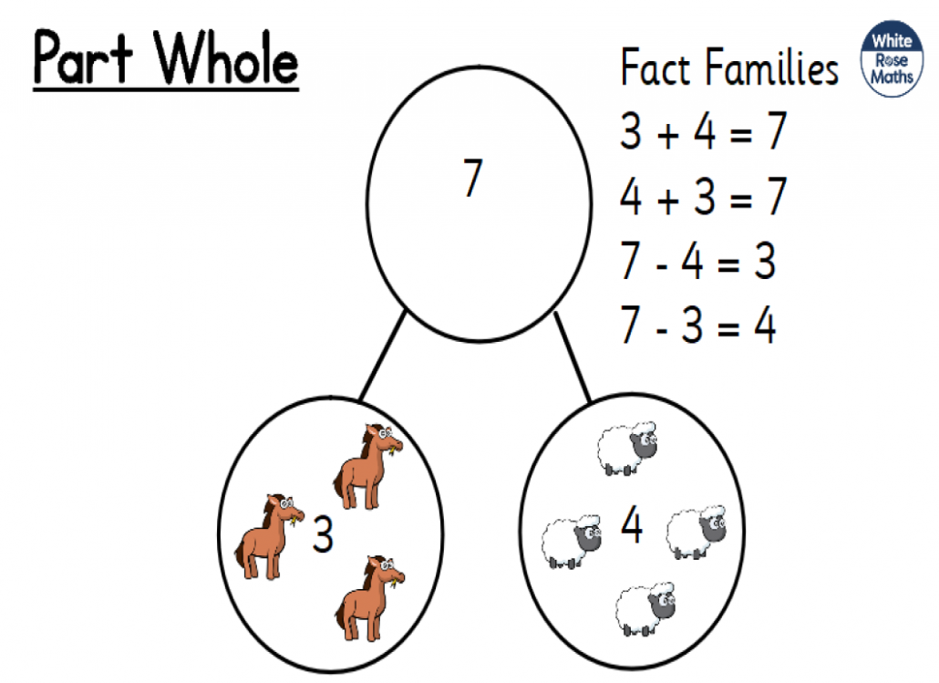
What is Part-Part Whole?
The Part-Part Whole model is the concept of how numbers can be split into parts. Children using this model will see the relationship between the whole number and the component parts, this helps learners make the connections between addition and subtraction.
Part-Part Whole reasoning also helps pupils to interpret, visualise and solve word problems.
The concept of part-whole model reasoning is introduced to children as early as 3/4 years old. It is used in small quantities where children should be able to see how many of something is there without counting, instead, they will subitise.
https://www.youtube.com/watch?v=vzeeaxLQDkE

Slide 12
How can I help at home?
• Count - steps up the stairs, money into a money box etc
• Ask children to say how many without counting (5 or fewer)
• Play games using dice/dominoes and encourage child to say how many spots without counting.
• Ask children to set the table with enough knives, forks and plates for everyone.
• Spot numbers in the environment – on phones, microwaves, clocks, registration plates, doors.
• Ask children to think of their own representations for numbers eg one of them, two hands, three bears, four wheels on a car, five toes, six sides on a dice, seven dwarves, eight legs on an octopus etc
• Deliberately make mistakes. Children need to understand mistakes are normal and everyone makes them eg get mixed up when counting, muddle two numbers when ordering them.
• Watch Numberblocks on Cbeebies. This programme is written by maths specialists to model maths concepts and represents number brilliantly. Also, Numberjacks is excellent for solving problems.
• Hide numbers around the house or garden for children to find.
• Play outdoor maths games like hopscotch and skittles. Even better, let children make up their own games and decide how to score points.
• Read books with maths concepts eg The Very Hungry Caterpillar, One is a snail, ten is a crab, What’s the time, Mr Wolf? The doorbell rang.
• Draw attention to more and less.
• Try some activities from the NRICH website for EYFS to encourage depth - www.nrich.maths.org (please be mindful that we will be using some of these in school) Ask questions such as “How many more?”, “How many altogether?”, “How many would I have if…”

