Slide 1
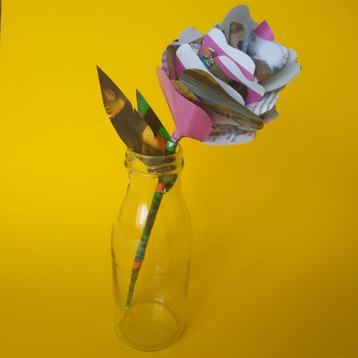
https://www.thelightbox.org.uk/blog/art-for-normals-paper-flowers
Can you make a paper flower for a friend ?

