Slide 1
Welcome to the Key Stage 2 SATs Presentation

Slide 2
The Big Picture
Children are formally assessed against national expectations at the following stages:
Year R baseline
Year 1- phonics
End of KS1 – Year 2
Multiplication check – Year 4
End of KS2 – Year 6
Children are continuously assessed by their teacher, in order to plan effectively for the next steps in their learning
Children in Year 6 will complete tests in May which are externally marked (apart from Writing which is assessed in school, but may be moderated)
All pupils complete the tests, apart from very rare exceptions

Slide 3
How are the tests used?
Results will be sent back to school towards the beginning of July.
The test results are automatically reported to the Secondary Schools and sent to parents, along with our teacher assessment, as part of the end of year school report.
Tests are used to judge national attainment and as a comparison between schools.
Tests indicate what a child can do on ONE day; the teacher assessment gives a picture of a child’s ability over time.
One change is that only the teacher assessment for writing is now submitted to West Sussex

Slide 4
Timetable for SATS
9th-12th May 2023
Tuesday 9 May: English grammar, punctuation and spelling (GPS) papers 1 (questions) and 2 (spelling)
Wednesday 10 May: English reading paper
Thursday 11 May: mathematics papers 1 (arithmetic) and 2 (reasoning)
Friday 12 May: mathematics paper 3 (reasoning)

Slide 5
Scores
Every pupil will receive:
  a raw score for each test
  a scaled score: 100+ is the national expectation, 110+ is Greater Depth
  The report you receive will not tell you if your child has achieved GD – you will need to look at the scaled score.

Slide 6
The Grammar Punctuation and Spelling Test
Spelling, punctuation and grammar
Spelling Test – 20 words (these words will follow the patterns from the year 5/6 spelling list, but will NOT be the actual words!)
Written paper – 45 minutes

Slide 7
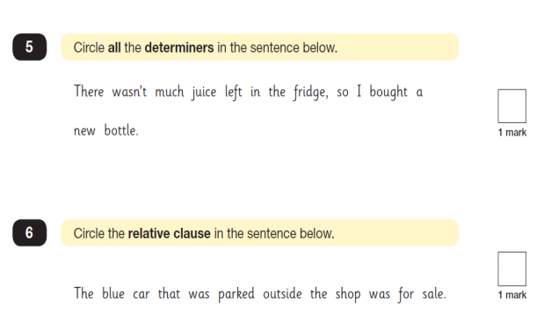

Slide 8
The Reading Test
Pupils are allowed 1 hour for the reading test.
The test will include 3 or 4 different texts – past examples include stories, poems, explanations, classic texts, interviews and accounts.
The questions will range from simple retrieval to more advanced inference and deduction.
Children should read one extract and then answer the relevant questions before moving on to reading the next extract.

Slide 9
There will be a selection of question types:
• Ranking/ordering, e.g. ‘Number the events below to show the order in which they happen in the story’
• Labelling, e.g. ‘Label the text to show the title of the story’
• Find and copy, e.g. ‘Find and copy one word that suggests what the weather is like in the story’
• Short constructed response, e.g. ‘What does the
bear eat?’
• Open-ended response, e.g. ‘Look at the sentence that begins Once upon a time. How does the writer increase the tension throughout this paragraph? Explain fully, referring to the text in your answer.’

Slide 10
Writing
There is no writing test.
Children will be continually assessed throughout the year through a variety of genres.
There is an increased emphasis on spelling
Joined cursive handwriting is critical in order to achieve age related expectations
In writing, Greater Depth is exceptional

Slide 11
The Maths Tests
There are 3 maths tests:
  Paper 1– Arithmetic: 30 minutes
  Paper 2 – Reasoning: 40 minutes
  Paper 3 – Reasoning: 40 minutes

Slide 12
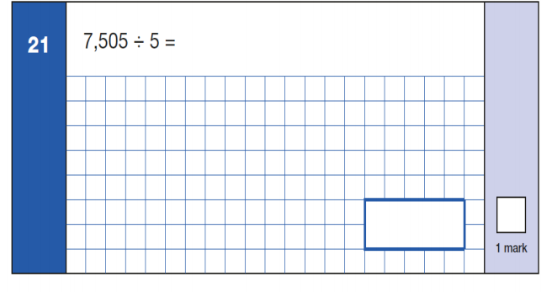

Slide 13
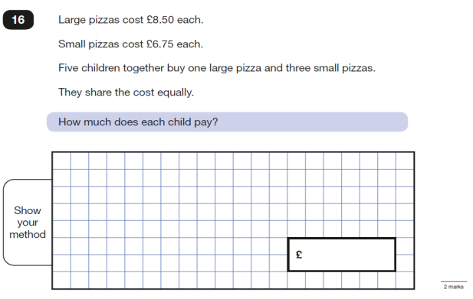

Slide 14
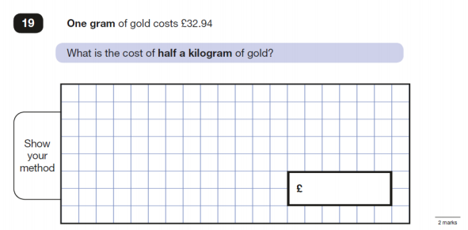

Slide 15
Access Arrangements
Tests will take place in classrooms and intervention rooms.
Children will be assessed by the Inclusion Manager/AHTs in February/March to see if they qualify for extra time or a reader.
Children can have a prompter, scribe and take rest breaks if necessary.
Tests can be photocopied onto cream paper for children who are dyslexic.

Slide 16
SATs Equipment
Sharp pencils
Handwriting pens
All other equipment will be provided by the school
Please practise with a protractor at home – you can borrow from the school.
No calculators

Slide 17
How are we supporting your children?
Covering the National Curriculum
Booster groups
Reading comprehension
Regular opportunities to write across a range of
genres
There will be opportunities to work through past SATs papers to familiarise children with the format of the paper and help them interpret questions. Trying our very best to not put the children under any unnecessary pressure; all we want them to do is try their best
A broad and balanced curriculum

Slide 18
How can you support your child?
Try to ensure no medical appointments take place during that week
Bedtime slightly earlier than normal during test week
Continue to support with homework, including reading, spelling and maths.
Try your very best to not put the children under any unnecessary pressure and let us know if your child is becoming anxious about the tests.
A decent breakfast
Bring an energy-giving snack to school and water bottle
PLEASE DO NOT PRACTISE USING TEST PAPERS FROM THE LAST THREE YEARS

Slide 19
SATS Revision Books
There will be 4 books to buy at a cost of £9 in total (details are available on ParentPay):
Maths question book
Maths revision book
English question book
English revision book

Slide 20
SATS Revision Books
Your child will be expected to complete 4 pages of the two question books (maths and English) per week. There will be no other homework set.
We would kindly ask that you mark your child’s work using the answers provided at the back of the books and have the book in school every Monday for the Class Teacher to check
It is very helpful if you could highlight or write us a note of areas your child found tricky inside the front cover and we will address this in school.

Slide 21
Life after the Tests
Results will be sent back to school towards the beginning of July.
The test results and a teacher assessment will be reported to parents and to the secondary schools
Leavers “do”, production, church services, residential etc

Slide 22
Thank you for all your
support

