Slide 1
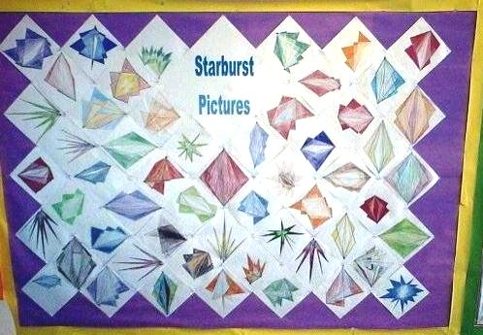
Remember you are all stars !!
You will need a scrap piece of paper and a ruler to practice
https://www.teachingideas.co.uk/line-in-art/starburst-pictures

