Slide 1
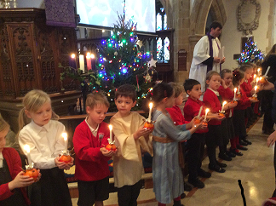
Welcome to our Infant Christingle Service
Friday 20th December 2019

Slide 2
WELCOME: – Introduction to the Christingle
When you’re a Star
8 Bars
Look how she twinkles, look how she dazzles,
It’s easy when you’re a star,
Look how she sparkles,
Look how she glitters and shines.
Lighting the way.
Look how she twinkles, look how she dazzles,
It’s easy when you’re a star,
And everybody wants to see the Star of Bethlehem shine.

Slide 3
2 Bars
Look how she twinkles, look how she dazzles,
It’s easy when you’re a star,
Look how she sparkles,
Look how she glitters and shines.
Lighting the way.
Look how she twinkles, look how she dazzles,
It’s easy when you’re a star,
And everybody wants to see the Star of Bethlehem shine.
2 Bars
I love a bit of glamour,
I love a bit of bling,
To see my name in lights,
It makes me want to sing.
I love a bit of glitz,
I love a bit of jazz,
I love to light the way
With my razzmatazz!

Slide 4
3 Bars
Look how she twinkles, look how she dazzles,
It’s easy when you’re a star,
Look how she sparkles,
Look how she glitters and shines.
Lighting the way.
Look how she twinkles, look how she dazzles,
It’s easy when you’re a star,
And everybody wants to see the Star of Bethlehem shine.
You know it’s true.
Everybody wants to see the Star of Bethlehem shine.
The pleasure’s mine.
Everybody wants to see the Star of Bethlehem shine.

Slide 5
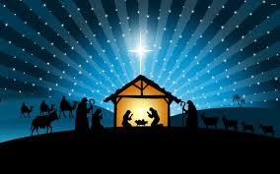
Year 1 Christmas Poem

Slide 6
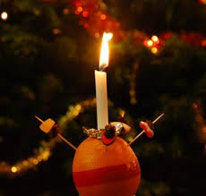
Christingle ceremony
Music (It’s a magical time of the year) will be played whilst the children collect their Christingle candles.
Please can all parents/carers remain seated at this time for the health and safety of all the children.
When the Christingle candles are lit the children will sing the first verse of Away in a manger and all to sing the remaining verses.

Slide 7
Away in a Manger
(Children only) 4 Bars
Away in a manger, no crib for a bed,
The little Lord Jesus laid down his sweet head.
The stars in the bright sky looked down where he lay,
The little Lord Jesus asleep on the hay.
ALL (2 Bars)
The cattle are lowing, the baby awakes,
But little Lord Jesus no crying he makes,
I love thee, Lord Jesus! Look down from the sky,
And stay by my side until morning is nigh.
2 Bars
Be near me, Lord Jesus, I ask thee to stay
Close by me for ever, and love me I pray.
Bless all the dear children in thy tender care,
And fit us for heaven, to live with thee there.

Slide 8
Year 2 Christmas Poem

Slide 9
It was on a Starry Night
4 Bars
It was on a starry night
When the hills were bright,
Earth lay sleeping, sleeping calm and still.
Then in a cattle shed
In a manger bed,
A boy was born King of all the world.
2 Bars
And all the angels sang for Him,
The bells of heaven rang for Him,
For a boy was born King of all the world,
And all the angels sang for Him,
The bells of heaven rang for Him,
For a boy was born King of all the world.

Slide 10
4 Bars
Soon the shepherds came that way
Where the Baby lay
And were kneeling, kneeling by His side,
And their hearts believed again
For the peace of men,
For a boy was born King of all the world.
2 Bars
And all the angels sang for Him,
The bells of heaven rang for Him,
For a boy was born King of all the world,
And all the angels sang for Him,
The bells of heaven rang for Him,
For a boy was born King of all the world.

Slide 11
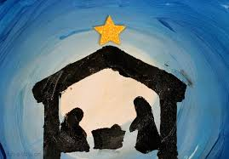
Paintings of the Christmas Story presented by Reception

Slide 12
Blessing

Slide 13
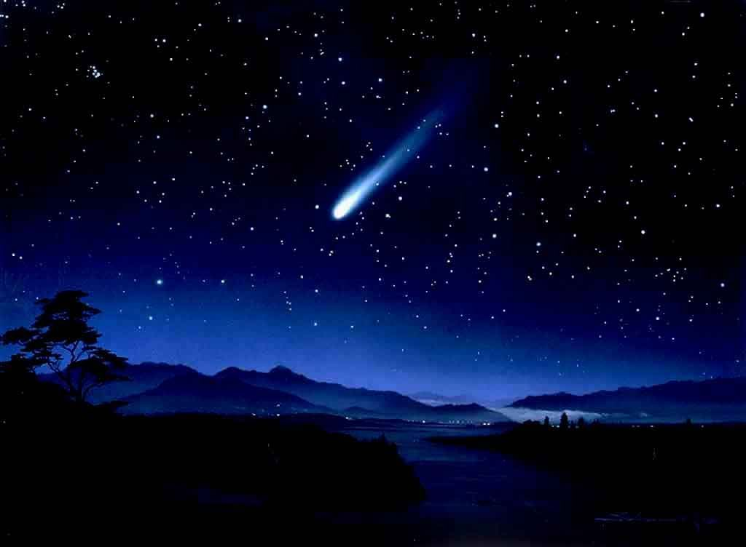
Silent Night
8 Bars
Silent night! Holy night!
All is calm, all is bright,
Round yon virgin mother and child,
Holy infant, so tender and mild,
Sleep in heavenly peace,
Sleep in heavenly peace.
2 Bars
Silent night! Holy night!
Shepherds quake at the sight;
Glories stream from heaven afar,
Heavenly hosts sing Alleluia!
Christ the Saviour is born,
Christ the Saviour is born.
2 Bars
Silent night! Holy night!
Son of God, love's pure light;
Radiant beams Thy holy face
With the dawn of redeeming grace,
Jesus, Lord, at Thy birth,
Jesus, Lord, at Thy birth.

Slide 14
Thank you for joining us for this Christingle Service and for all your donations to the Children’s Society. We would like to wish you and your families a happy and peaceful Christmas.
And the angel answered her, “The Holy Spirit will come upon you, and the power of the Most High will overshadow you; therefore the child to be born will be called holy-the Son of God.”
Luke 1:35
Thank you very much to Holy Trinity Church for their support at this service.
(At the end of the service please can parents/carers remain seated while the children leave the Church with staff and walkers to return to school. Thank you.)

